Slide 1


ACCT 2003F Intermediate Financial Accounting 中级财务会计
THE HITSZ
SCHOOL OF ECONOMICS
AND MANAGEMENT
授课人：墙伟
2024.10.28

Slide 2

LEARNING OBJECTIVES
CHAPTER 13
Current Liabilities,
Provisions, and Contingencies
After studying this chapter, you should be able to:
Describe the nature, valuation, and reporting of current liabilities.
Explain the accounting for different types of provisions.
Explain the accounting for loss and gain contingencies.
Indicate how to present and analyze liability-related information.

Slide 3
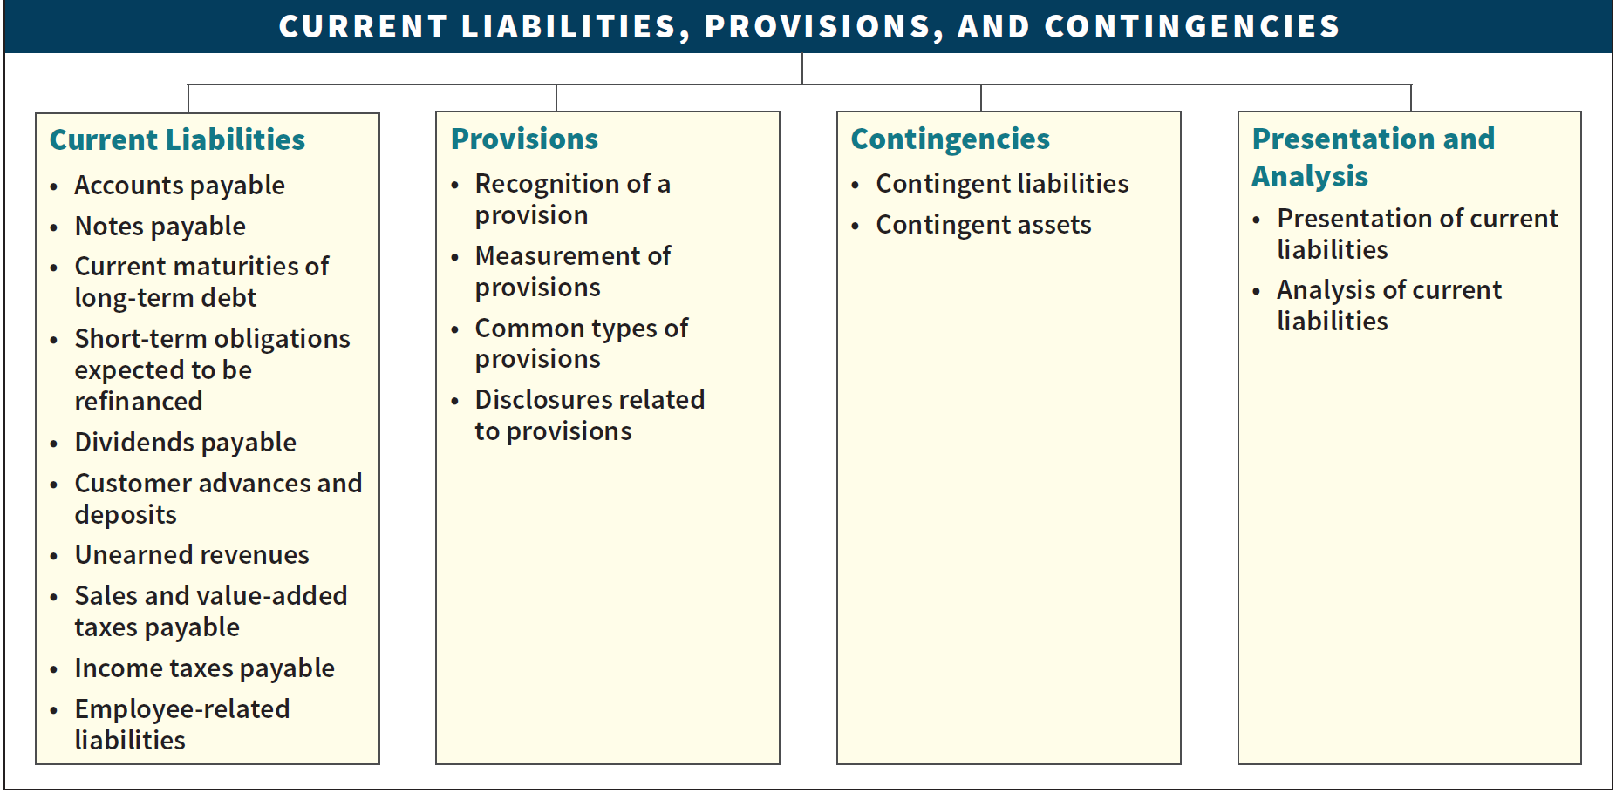
PREVIEW OF CHAPTER 13
Intermediate Accounting
IFRS 4th Edition
Kieso ● Weygandt ● Warfield

Slide 4
Corporate debt structure of U.S. companies
短期负债 长期负债

Slide 5
LEARNING OBJECTIVE 1
Describe the nature, valuation, and reporting of current liabilities.

Slide 6
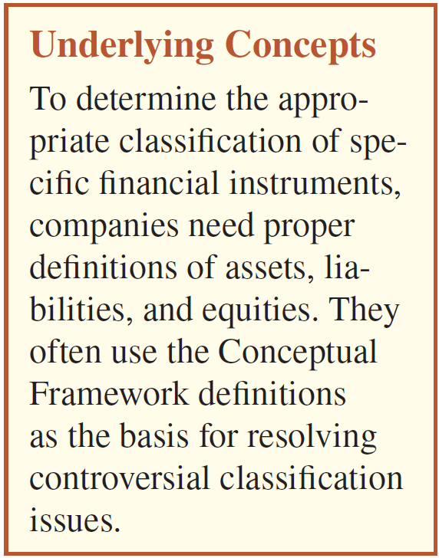
Current Liabilities 短期负债
Three essential characteristics:
Present obligation. 现时义务
Arises from past events. 由过去的事项产生。
Requires a transfer of economic resources (cash, goods, services). 导致经济资源流出。
LO 1
Notes:
a liability as a present obligation of the entity to transfer an economic resource as a result of past events

Slide 7

单选题
1分
Quick Check #1
Liabilities are
A
accounts having credit balances after closing entries are made.
B
deferred credits that are recognized and measured in conformity with IFRS.
C
obligations to transfer ownership shares to other entities in the future.
D
obligations arising from past transactions and payable in assets or services in the future.
Submit

Slide 8
Current Liabilities 短期负债
A current liability 短期负债 is reported if one of two conditions exists:
Liability is expected to be settled within its normal operating cycle; or
Liability is expected to be settled within 12 months after the reporting date.
The operating cycle 经营周期 is the period of time elapsing between the acquisition of goods and services and the final cash realization resulting from sales and subsequent collections.
LO 1
Notes:
A company must satisfy currently maturing obligations in the ordinary course of business to continue operating. Liabilities with a more distant due date do not, as a rule, represent a claim on the company’s current resources. They are therefore in a slightly different category. This feature gives rise to the basic division of liabilities into (1) current liabilities and (2) non-current liabilities.

Slide 9
Current Liabilities 短期负债
Typical Current Liabilities:
Customer advances and deposits. 客户预付款和保证金
Unearned revenues. 预收账款
Sales and value-added taxes payable. 应交消费税/增值税
Income taxes payable. 应交所得税
Employee-related liabilities.
Accounts payable. 应付账款
Notes payable. 应付票据
Current maturities of long-term debt. 一年内到期的非流动负债
Short-term obligations expected to be refinanced. 预期再融资的短期债务
Dividends payable. 应付股利
LO 1

Slide 10
Current Liabilities 短期负债
Accounts Payable (trade accounts payable)
应付账款
Balances owed to others for goods, supplies, or services purchased on open account.
Time lag between the receipt of services or acquisition of title to assets and the payment for them.
Terms of the sale (e.g., 2/10, n/30 or 1/10, E.O.M.) usually state period of extended credit, commonly 30 to 60 days.
LO 1

Slide 11
Current Liabilities 短期负债
Notes Payable 应付票据
Written promises to pay a certain sum of money on a specified future date.
Arise from purchases, financing, or other transactions.
Notes classified as short-term or long-term.
Notes may be interest-bearing 带息票据 or zero-interest-bearing 零息票据.
LO 1
Notes:
Notes payable to banks or loan companies generally arise from cash loans.

Slide 12
Current Liabilities 短期负债
Interest-Bearing Note Issued 带息票据
Illustration: Castle Bank agrees to lend €100,000 on March 1, 2019, to Landscape Co. if Landscape signs a €100,000, 6 percent, four-month note. Landscape records the cash received on March 1 as follows:
Date | Account | Debit | Credit
March 1, 2019 | Cash 银行存款 | 100,000
 | Notes Payable 应付票据 |  | 100,000
LO 1

Slide 13
Interest-Bearing Note Issued 带息票据
If Landscape prepares financial statements semiannually, it makes the following adjusting entry to recognize interest expense and interest payable at June 30, 2019:
Interest calculation =
(€100,000 x 6% x 4/12) = €2,000
Date | Account | Debit | Credit
June 30, 2019 | Interest Expense 财务费用 | 2,000
 | Interest Payable 应付利息 |  | 2,000
LO 1

Slide 14
Interest-Bearing Note Issued 带息票据
At maturity (July 1, 2020), Landscape records payment of the note and accrued interest as follows.
Date | Account | Debit | Credit
July 1, 2019 | Notes Payable 应付票据 | 100,000
 | Interest Payable 应付利息 | 2,000
 | Cash 银行存款 |  | 102,000
LO 1

Slide 15
Current Liabilities 短期负债
Zero-Interest-Bearing Note Issued 零息票据
Illustration: On March 1, Landscape issues a €102,000, four-month, zero-interest-bearing note to Castle Bank. The present value of the note is €100,000. Landscape records this transaction as follows.
Date | Account | Debit€ | Credit€
March 1, 2019 | Cash 银行存款 | 100,000
 | Notes Payable 应付票据 |  | 100,000
LO 1

Slide 16
Zero-Interest-Bearing Note Issued 零息票据
If Landscape prepares financial statements semiannually, it makes the following adjusting entry to recognize interest expense and the increase in the note payable of €2,000 at June 30.
Date | Account | Debit€ | Credit€
June 30, 2019 | Interest Expense 财务费用 | 2,000
 | Notes Payable 应付票据 |  | 2,000
At maturity (July 1), Landscape must pay the note, as follows.
Date | Account | Debit€ | Credit€
July 1, 2019 | Notes Payable 应付票据 | 102,000
 | Cash 银行存款 |  | 102,000
LO 1

Slide 17
Current Liabilities 短期负债
Current Maturities of Long-Term Debt
一年内到期的非流动负债
Portion of bonds 债券, mortgage notes 抵押票据, and other long-term indebtedness that matures within the next fiscal year.
Exclude long-term debts maturing currently if they are to be:
Refinanced, or retired from the proceeds of a new long-term debt issue, or
Converted into ordinary shares.
LO 1
Notes:
The currently maturing portion of non-current debts may be classified as a current liability. When a portion of non-current debt is so classified, it is assumed that the amount will be paid within the next 12 months out of funds classified as current assets.
However, a company should classify as current any liability that is due on demand (callable by the creditor), or will be due on demand within one year (or operating cycle, if longer). Liabilities often become callable by the creditor when there is a violation of the debt agreement.
To illustrate a breach of a covenant, assume that Gyro Company on November 1, 2022, has a long-term note payable to Sanchez SA, which is due on April 1, 2024. Unfortunately, Gyro breaches a covenant in the note, and the obligation becomes payable on demand. Gyro is preparing its financial statements at December 31, 2022. Given the breach in the covenant, Gyro must classify its obligation as current. However, Gyro can classify the liability as non-current if Sanchez agrees before December 31, 2022, to provide a grace period for the breach of the agreement. The grace period must end at least 12 months after December 31, 2022, to be reported as a non-current liability. If the agreement is not finalized by December 31, 2022, Gyro must classify the note payable as a current liability.

Slide 18
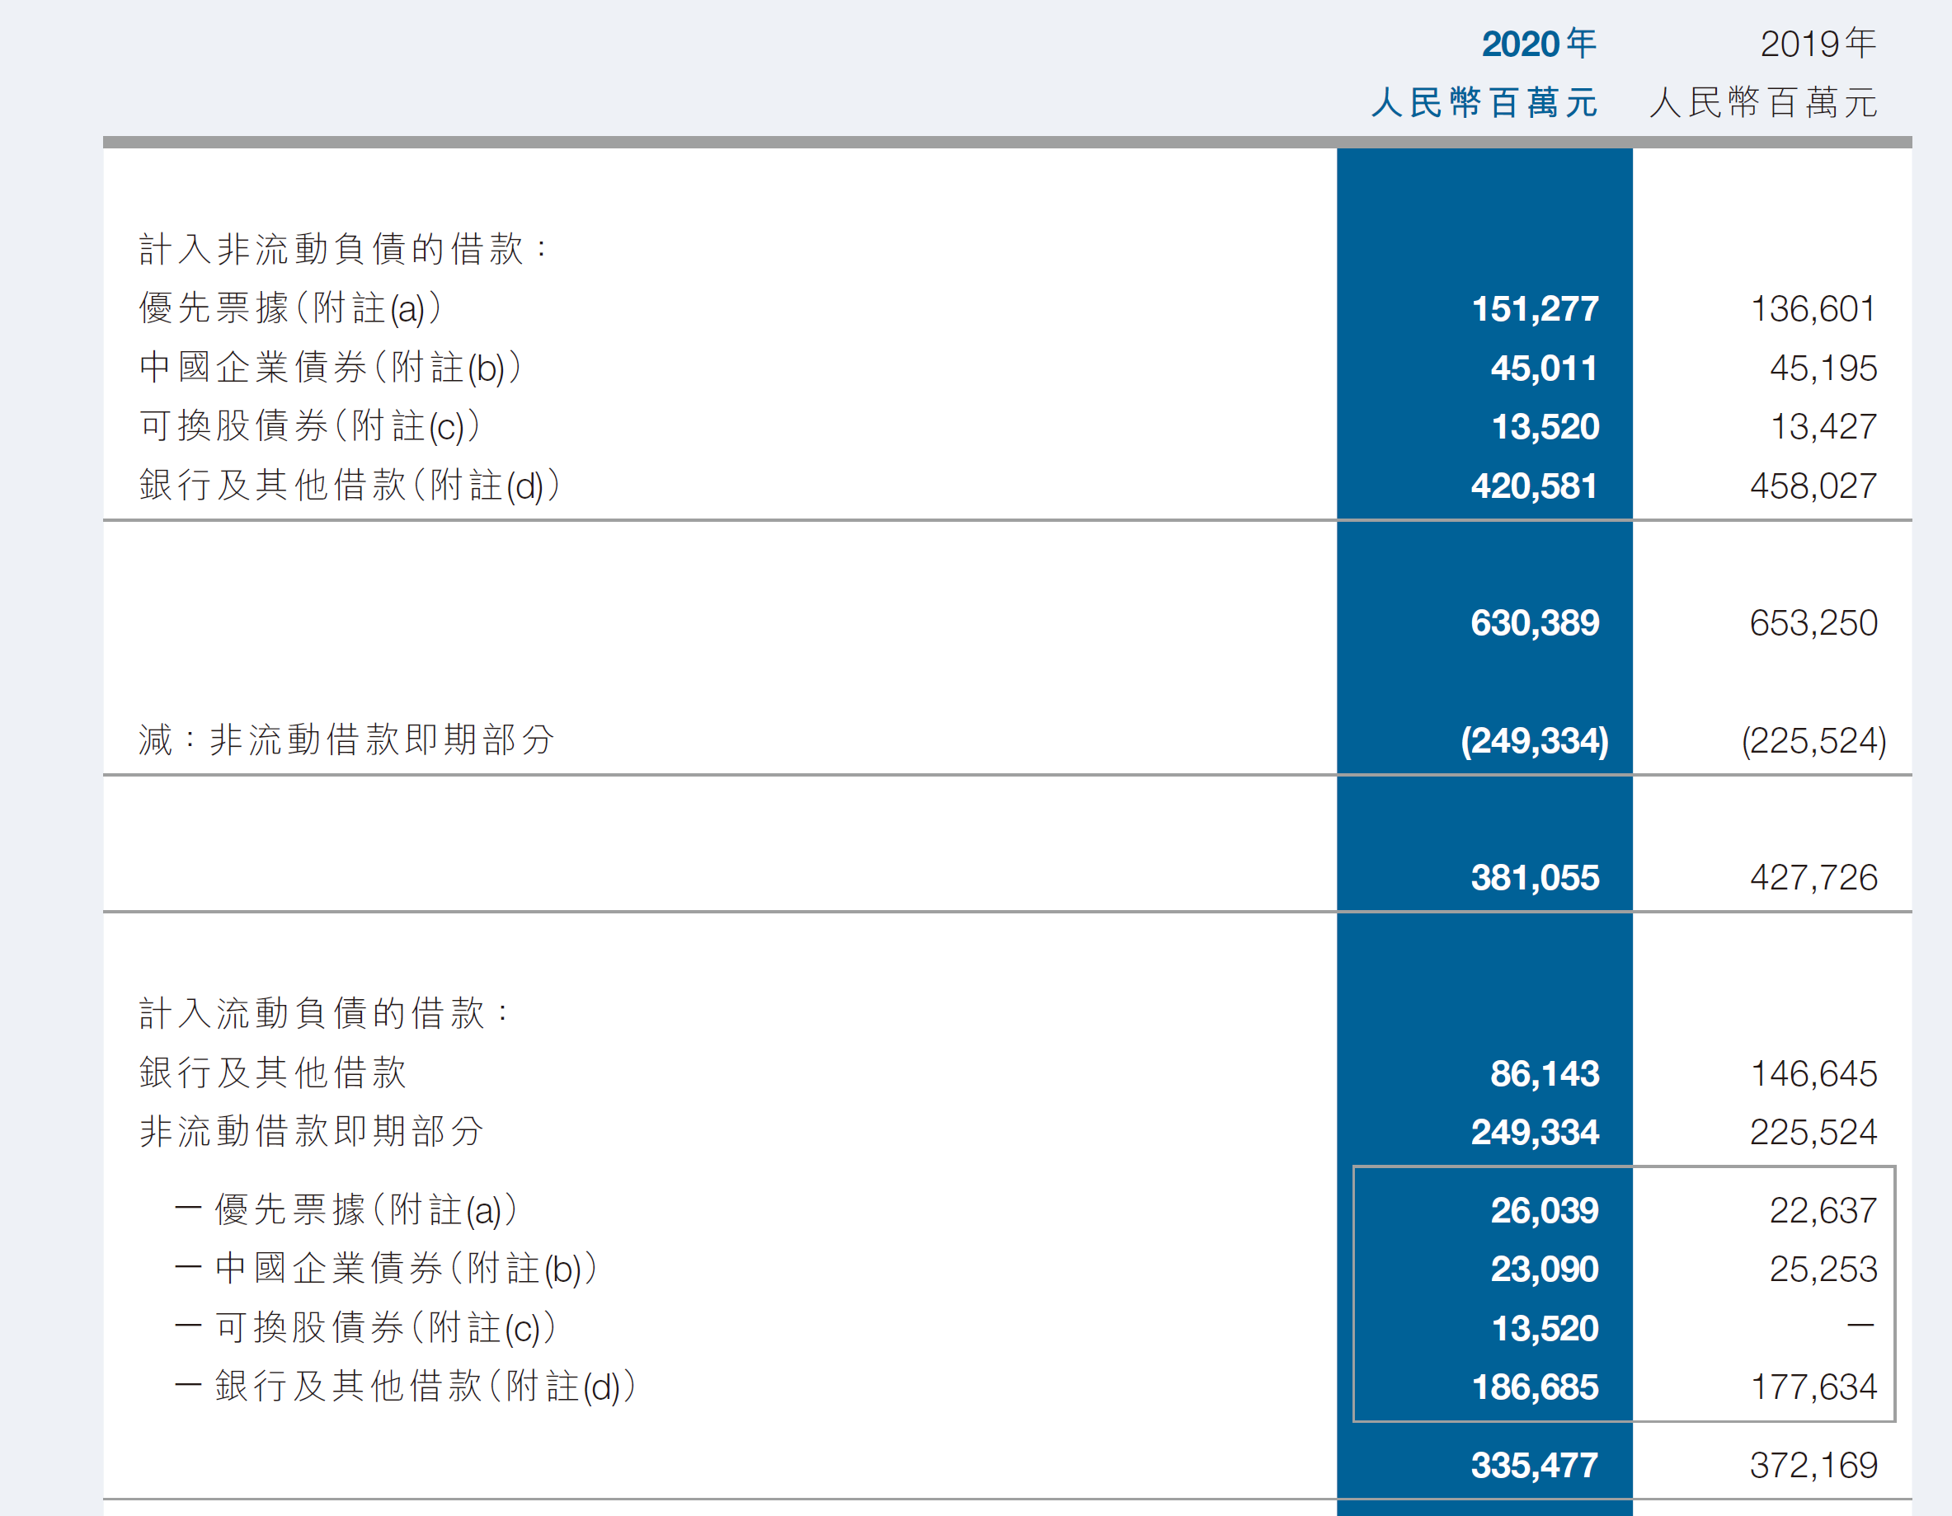
China Evergrande Group
LO 1
Notes:
The currently maturing portion of non-current debts may be classified as a current liability. When a portion of non-current debt is so classified, it is assumed that the amount will be paid within the next 12 months out of funds classified as current assets.
However, a company should classify as current any liability that is due on demand (callable by the creditor), or will be due on demand within one year (or operating cycle, if longer). Liabilities often become callable by the creditor when there is a violation of the debt agreement.
To illustrate a breach of a covenant, assume that Gyro Company on November 1, 2022, has a long-term note payable to Sanchez SA, which is due on April 1, 2024. Unfortunately, Gyro breaches a covenant in the note, and the obligation becomes payable on demand. Gyro is preparing its financial statements at December 31, 2022. Given the breach in the covenant, Gyro must classify its obligation as current. However, Gyro can classify the liability as non-current if Sanchez agrees before December 31, 2022, to provide a grace period for the breach of the agreement. The grace period must end at least 12 months after December 31, 2022, to be reported as a non-current liability. If the agreement is not finalized by December 31, 2022, Gyro must classify the note payable as a current liability.

Slide 19
Current Liabilities 短期负债
Short-Term Obligations Expected to Be Refinanced 预期再融资的短期债务
Exclude from current liabilities if both of the following conditions are met:
Must intend to refinance the obligation on a long-term basis.
Must have an unconditional right to defer settlement of the liability for at least 12 months after the reporting date.
LO 1

Slide 20
Current Liabilities 短期负债
E13-4 (Refinancing of Short-Term Debt 短期负债再融资): The CFO for Yong Corporation is discussing with the company’s chief executive officer issues related to the company’s short-term obligations. Presently, both the current ratio and the acid-test ratio for the company are quite low, and the chief executive officer is wondering if any of these short-term obligations could be reclassified as long-term. The financial reporting date is December 31, 2018. Two short-term obligations were discussed, and the following action was taken by the CFO.
Instructions: Indicate how these transactions should be reported at Dec. 31, 2018, on Yongs’ statement of financial position.
LO 1

Slide 21
Current Liabilities 短期负债
Short-Term Obligation A: Yong has a $50,000 short-term obligation due on March 1, 2019. The CFO discussed with its lender whether the payment could be extended to March 1, 2021, provided Yong agrees to provide additional collateral. An agreement is reached on February 1, 2019, to change the loan terms to extend the obligation’s maturity to March 1, 2021. The financial statements are authorized for issuance on April 1, 2019.
Liability of $50,000
Refinance completed
Liability due for payment
Statement Issuance
Dec. 31, 2018
Feb. 1, 2019
Mar. 1, 2019
Apr. 1, 2019
LO 1

Slide 22
Current Liabilities 短期负债
Short-Term Obligation A: Yong has a $50,000 short-term obligation due on March 1, 2019. The CFO discussed with its lender whether the payment could be extended to March 1, 2021, provided Yong agrees to provide additional collateral. An agreement is reached on February 1, 2019, to change the loan terms to extend the obligation’s maturity to March 1, 2021. The financial statements are authorized for issuance on April 1, 2019.
Current Liability of $50,000
Since the agreement was not in place as of the reporting date (December 31, 2019), the obligation should be reported as a current liability.
Dec. 31, 2019
LO 1

Slide 23
Current Liabilities 短期负债
Short-Term Obligation B: Yong also has another short-term obligation of $120,000 due on February 15, 2019. In its discussion with the lender, the lender agrees to extend the maturity date to February 1, 2020. The agreement is signed on December 18, 2018. The financial statements are authorized for issuance on March 31, 2019.
Refinance completed
Liability of $120,000
Liability due for payment
Statement Issuance
Dec. 18, 2018
Dec. 31, 2018
Feb. 15, 2019
Mar. 31, 2019
LO 1

Slide 24
Current Liabilities
Short-Term Obligation B: Yong also has another short-term obligation of $120,000 due on February 15, 2019. In its discussion with the lender, the lender agrees to extend the maturity date to February 1, 2020. The agreement is signed on December 18, 2018. The financial statements are authorized for issuance on March 31, 2019.
Non-Current
Liability of $120,000
Refinance completed
Since the agreement was in place as of the reporting date (December 31, 2018), the obligation is reported as a non-current liability.
Dec. 18, 2018
Dec. 31, 2018
LO 1

Slide 25
Quick Check #2
单选题
1分
Short-term obligations expected to be refinanced are not classified as current liabilities if
A
they will be paid using restricted cash.
B
the obligations will be satisfied after the financial statements are issued.
C
their satisfaction will not require the use of assets classified as current as of the statement of financial position date.
D
None of these answers are correct.
Submit

Slide 26
Current Liabilities 短期负债
Dividends Payable 应付股利 (现金)
Amount owed by a corporation to its stockholders as a result of board of directors’ authorization.
Generally paid within three months.
Undeclared dividends 未宣告的股息 on cumulative preference shares are not recognized as a liability.
Dividends payable in the form of additional shares 股票股利 are not recognized as a liability.
Reported in equity.
LO 1
Notes:
At the date of declaration, the company assumes a liability that places the shareholders in the position of creditors in the amount of dividends declared.
Because companies always pay cash dividends within one year of declaration (generally within three months), they classify them as current liabilities.
On the other hand, companies do not recognize accumulated but undeclared dividends on cumulative preference shares as a liability. Why? Because preference dividends in arrears are not an obligation until the board of directors authorizes the payment.
Dividends payable in the form of additional shares are not recognized as a liability. Such share dividends (as we discuss in Chapter 15) do not require future outlays of assets or services. Companies generally report such undistributed share dividends in the equity section because they represent retained earnings in the process of transfer to share capital.

Slide 27
Current Liabilities 短期负债
Customer Advances and Deposits 客户预付款和保证金
Returnable cash deposits received from customers and employees.
May be classified as current or non-current liabilities.
depends on the time between the date of the deposit and the termination of the relationship that required the deposit.
LO 1
Notes:
Companies may receive deposits from customers to guarantee performance of a contract or service or as guarantees to cover payment of expected future obligations.
The classification of these items as current or non-current liabilities depends on the time between the date of the deposit and the termination of the relationship that required the deposit.

Slide 28
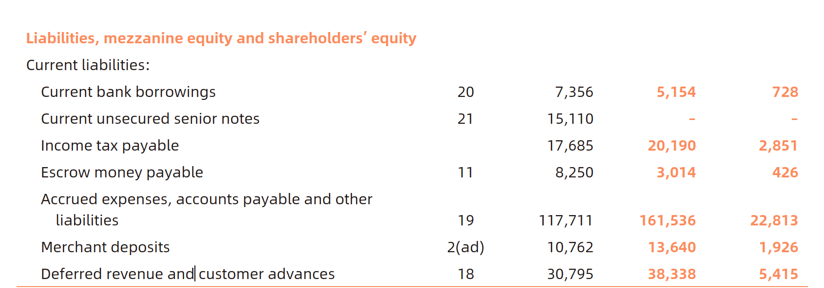
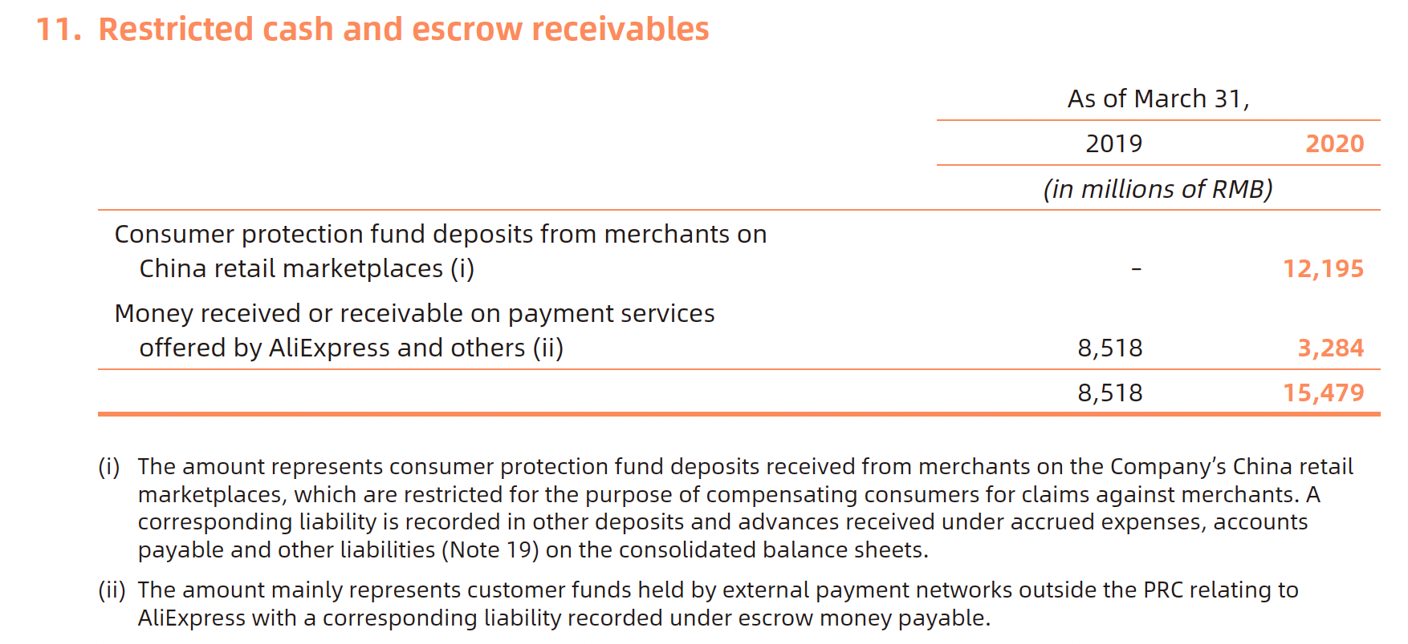
Alibaba 2019

Slide 29
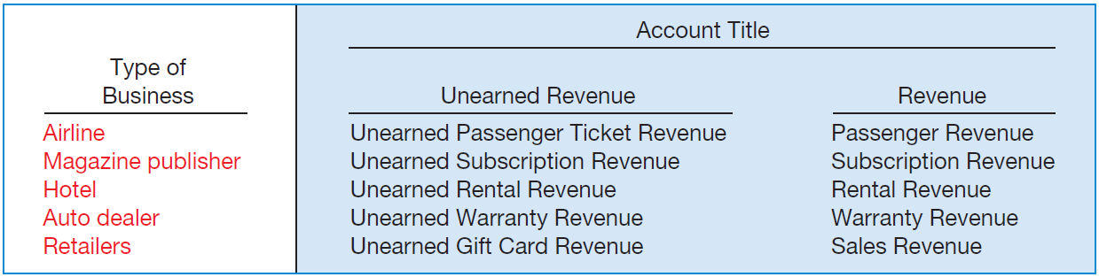
Current Liabilities 短期负债
Unearned Revenues 预收账款
Payment received before providing goods or performing services.
ILLUSTRATION 13.2
Unearned and Earned Revenue Accounts
LO 1
Notes:
How do these companies account for unearned revenues that they receive before providing goods or performing services?
1. When a company receives an advance payment, it debits Cash and credits a current liability account identifying the source of the unearned revenue.
2. When a company recognizes revenue, it debits the unearned revenue account and credits a revenue account.

Slide 30
Current Liabilities
BE13-6: Sports Pro Magazine sold 12,000 annual subscriptions on August 1, 2019, for €18 each. Prepare Sports Pro’s August 1, 2019, journal entry and the December 31, 2019, annual adjusting entry.
Date | Account | Debit€ | Credit€
Aug. 1 Cash 银行存款 216,000
Unearned Revenue 预收账款 216,000
(12,000 x €18)
Dec. 31 Unearned Revenue 预收账款 90,000
Subscription Revenue 主营业务收入 90,000
(€216,000 x 5/12 = €90,000)
LO 1

Slide 31
Current Liabilities
Sales and Value-Added Taxes Payable
应交消费税/增值税
Consumption taxes are generally either
a sales tax or 消费税
a value-added tax (VAT). 增值税
Purpose is to generate revenue for the government.
The two systems use different methods to accomplish this objective.
LO 1
Notes:
消费税和增值税

Slide 32
Sales Taxes Payable 应交消费税
Illustration: Halo Supermarket sells loaves of bread to consumers on a given day for €2,400. Assuming a sales tax rate of 10 percent, Halo Supermarket makes the following entry to record the sale.
Date | Account | Debit€ | Credit€
Cash 银行存款 2,640
Sales Revenue 主营业务收入 2,400
Sales Taxes Payable 应交税费—应交消费税 240
LO 1
Notes:
Sales Taxes Payable
应交税费-应交消费税

Slide 33
Value-Added Taxes Payable 应交增值税
Illustration: The VAT is collected every time a business purchases products from another business in the product’s supply chain. To illustrate,
Hill Farms Wheat Company grows wheat and sells it to Sunshine Baking for €1,000. Hill Farms Wheat makes the following entry to record the sale, assuming the VAT is 10 percent.
Date | Account | Debit€ | Credit€
Cash 银行存款 1,100
Sales Revenue 主营业务收入 1,000
Value-Added Taxes Payable 100
应交税费—应交增值税（销项税额）
LO 1
Notes:
Value-Added Taxes Payable
应交税费-应交增值税（销项税额）

Slide 34
Value-Added Taxes Payable应交增值税
Sunshine Baking makes loaves of bread from this wheat and sells it to Halo Supermarket for €2,000. Sunshine Baking makes the following entry to record the sale, assuming the VAT is 10 percent.
Date | Account | Debit€ | Credit€
Cash 银行存款 2,200
Sales Revenue 主营业务收入 2,000
Value-Added Taxes Payable 200
应交税费—应交增值税（销项税额）
Sunshine Baking then remits €100 to the government, not €200. The reason: Sunshine Baking has already paid €100 to Hill Farms Wheat.
LO 1

Slide 35
Value-Added Taxes Payable应交增值税
Halo Supermarket sells the loaves of bread to consumers for €2,400. Halo Supermarket makes the following entry to record the sale, assuming the VAT is 10 percent.
Date | Account | Debit€ | Credit€
Cash 银行存款 2,640
Sales Revenue 主营业务收入 2,400
Value-Added Taxes Payable 240
应交税费—应交增值税（销项税额）
Halo Supermarket then sends only €40 to the tax authority as it deducts the €200 VAT already paid to Sunshine Baking.
LO 1

Slide 36
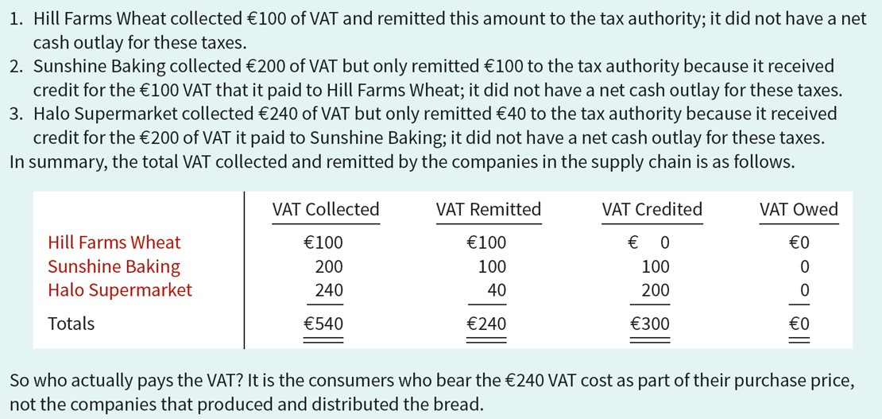
Who Pays the VAT? 应交增值税
ILLUSTRATION 13.3
L O 1

Slide 37
Current Liabilities 短期负债
Income Tax Payable 应交所得税
Businesses must prepare an income tax return and compute the income tax payable.
Taxes payable are a current liability.
Corporations must make periodic tax payments.
Differences between taxable income and accounting income sometimes occur (Chapter 19).
LO 1
Notes:
Income Tax Payable
应交税费——应交所得税

Slide 38
Current Liabilities 短期负债
Employee-Related Liabilities 员工相关负债
Amounts owed to employees for salaries or wages are reported as a current liability.
Current liabilities may include:
Payroll deductions. 工资扣除
Compensated absences. 带薪缺勤
Bonuses. 短期利润分享计划
LO 1
Notes:
应付职工薪酬

Slide 39
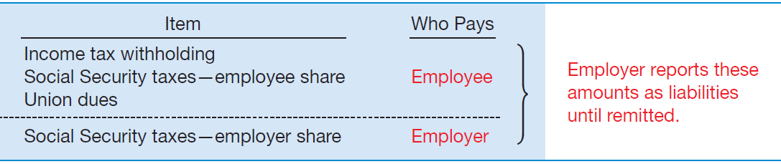
Employee-Related Liabilities 员工相关负债
Payroll Deductions 工资扣款
Taxes:
Social Security Taxes 社会保险费用
Income Tax Withholding 个人所得税代扣代缴
ILLUSTRATION 13.4
Summary of Payroll Liabilities
LO 1
Notes:
Social Security Taxes
社保费用
Income Tax Withholding
个人所得税代扣代缴

Slide 40
Employee-Related Liabilities 员工相关负债
Illustration: Assume a weekly payroll of $10,000 entirely subject to Social Security taxes (8%), with income tax withholding of $1,320 and union dues of $88 deducted. The company records the wages and salaries paid and the employee payroll deductions as follows.
Date | Account | Debit€ | Credit€
Wages and Salaries Expense 10,000
管理费用——职工工资和福利费
应付职工薪酬——
Withholding Taxes Payable 1,320
个人所得税代扣代缴
Social Security Taxes Payable 800
社会保险费
Union Dues Payable 88
工会经费
Cash 银行存款 7,792
LO 1
Notes:
应付职工薪酬——工资
——医疗保险费
——住房公积金
——工会经费
——职工教育经费

Slide 41
Employee-Related Liabilities 员工相关负债
Illustration: Assume a weekly payroll of $10,000 entirely subject to Social Security taxes (8%), with income tax withholding of $1,320 and union dues of $88 deducted. The company records the employer payroll taxes as follows.
Date | Account | Debit€ | Credit€
Payroll Tax Expense 800
管理费用——职工工资和福利费
Social Security Taxes Payable 800
应付职工薪酬——社会保险费
The employer must remit to the government its share of Social Security tax along with the amount of Social Security tax deducted from each employee’s gross compensation.
LO 1

Slide 42
Employee-Related Liabilities 员工相关负债
Compensated Absences 带薪缺勤
Paid absences for vacation, illness and maternity, paternity, and jury leaves.
Vested rights 即得权利- employer has an obligation to make payment to an employee even after terminating his or her employment.
Accumulated rights 累积权利 - employees can carry forward to future periods if not used in the period in which earned.
Non-accumulating rights 非累积权利 - do not carry forward; they lapse if not used.
LO 1
Notes:
Non-accumulating rights do not carry forward; they lapse if not used. As a result, a company does not recognize a liability or expense until the time of absence (benefit).
Compensated Absences
带薪缺勤

Slide 43
Employee-Related Liabilities员工相关负债
Illustration: Amutron NV began operations on January 1, 2019. The company employs 10 individuals and pays each €480 per week. Employees earned 20 unused vacation weeks in 2019. In 2020, the employees used the vacation weeks, but now they each earn €540 per week. Amutron accrues the accumulated vacation pay on December 31, 2019, as follows.
Salaries and Wages Expense 管理费用 9,600
Salaries and Wages Payable 9,600
应付职工薪酬——累积带薪缺勤
In 2020, it records the payment of vacation pay as follows.
Salaries and Wages Payable 9,600
应付职工薪酬——累积带薪缺勤
Salaries and Wages Expense 管理费用 1,200
Cash 银行存款 10,800
LO 1
Notes:
Companies should recognize the expense and related liability for compensated absences in the year earned by employees.

Slide 44
Employee-Related Liabilities 员工相关负债
Profit-Sharing and Bonus Plans 利润分享计划
Payments to certain or all employees in addition to their regular salaries or wages.
Bonuses paid are an operating expense.
Unpaid bonuses should be reported as a current liability.
To illustrate the entries for an employee bonus, assume that Palmer Inc. shows income for the year 2022 of $100,000. It will pay out bonuses of $10,700 in January 2023. Palmer makes an adjusting entry dated December 31, 2022, to record the bonuses as follows.
Salaries and Wages Expense 10,700
管理费用
Salaries and Wages Payable——Profit-Sharing and Bonus Plans 10,700
应付职工薪酬——利润分享计划
LO 1
Notes:
A company may consider bonus payments to employees as additional salaries and wages and should include them as a deduction in determining the net income for the year.
The liability, Salaries and Wages Payable, is usually payable within a short period of time. Companies should include it as a current liability in the statement of financial position.
应付职工应酬——利润分享计划

Slide 45
Quick Check #3
单选题
1分
Which of the following statements is false?
When rights are vested, an employer has an obligation to make payment to an employee.
A
B
Social security taxes and income taxes withheld are expenses of the employer.
C
Profit-Sharing Bonus Payable is usually reported as a long-term liability.
D
The liability for compensated absences should be recognized in the year earned.
Submit

Slide 46


感谢您的参与！
THE HITSZ
SCHOOL OF ECONOMICS
AND MANAGEMENT

